Slide 1
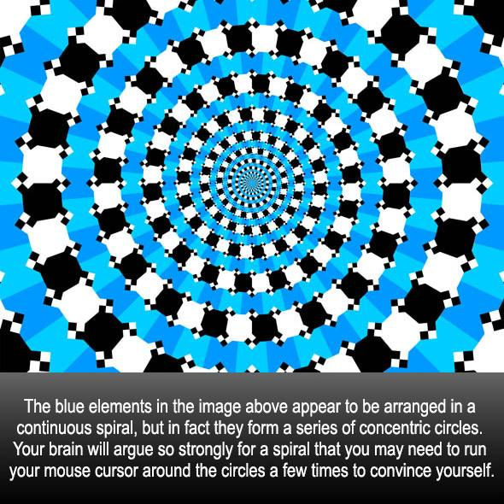

Slide 2
Dimitris Papailiopoulos
University of Wisconsin-Madison
Robustness of Predictions and Adversarial Examples

Slide 3
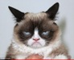
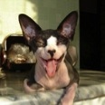
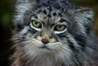
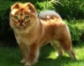


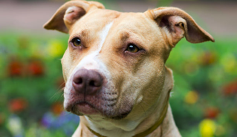
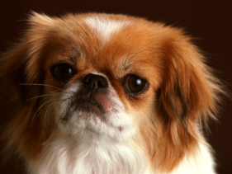
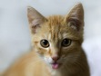
Standard ML Pipeline
Input Data

Slide 4
Standard ML Pipeline
Input Data
Training

Slide 5
Standard ML Pipeline
Input Data
Training
Model

Slide 6
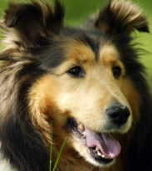
Standard ML Pipeline
This is called inference
Test (unseen) Data
Input Data
Training
Model
predicted
label:
“dog”

Slide 7
Today
Robustness of Models
Adversarial Examples
Attacks during Inference

Slide 8
Robustness of Classification
Robustness:
“The predictions are insensitive to small input perturbations”
Predict(model, ) ≈ Predict(model, )
Are classifiers robust?

Slide 9
Why robustness?

Slide 10
Why Robustness
Real world deployment
Security/Safety
Generalization beyond the test set
Need to understand/protect against failure modes

Slide 11
Robustness Against Random Noise

Slide 12
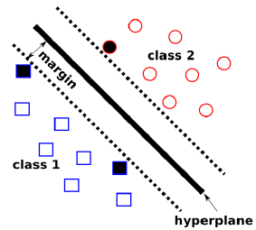
Robustness of Classification
Let’s study the linear case:
Assume some margin:
Prediction
Class 1
Class 2

Slide 13
Robustness of Classification
Assume additive perturbation
Gaussian 0-mean, unit variance
Assume that original input satisfies
Then, after noise is added
“γ-far” from boundary
How big is added term?

Slide 14
Robustness of Classification
Expected value
Variance

Slide 15
Robustness of Classification
Expected value
Variance

Slide 16
Robustness of Classification
Expected value
Variance

Slide 17
Robustness of Classification
Expected value
Variance

Slide 18
Robustness of Classification
For additive 0-mean, unit vector v,
The probability of misclasifying is
Probability that noise
obliterates margin

Slide 19
Robustness of Classification
For additive 0-mean, unit vector v,
The probability of misclasifying is
(standard Gaussian tail-bounds)
You need to misclasify
Ridiculously small!

Slide 20
Robustness of Classification
For additive 0-mean, unit vector v,
The probability of misclasifying is
(standard Gaussian tail-bounds)
You need to misclasify
Linear Classifiers are Robust
to Random noise
Ridiculously small!

Slide 21
Adversarial Examples

Slide 22

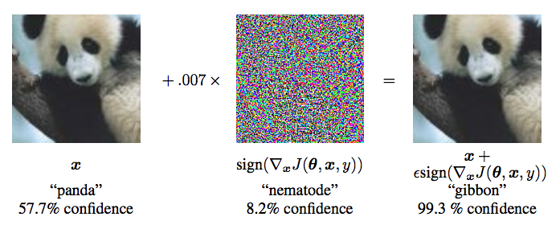
Adversarial Examples
Then, in 2014 something happened…
[Ian J. Goodfellow, Jonathon Shlens & Christian Szegedy, ICLR 2015]

Slide 23
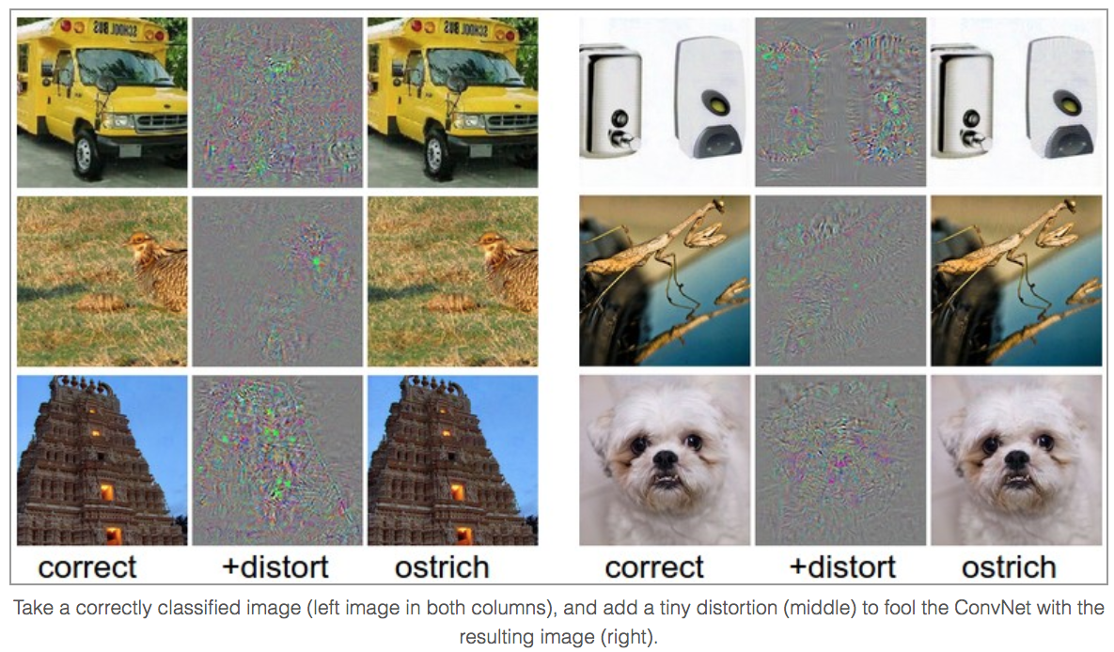
Adversarial Examples
[http://karpathy.github.io/2015/03/30/breaking-convnets/]

Slide 24
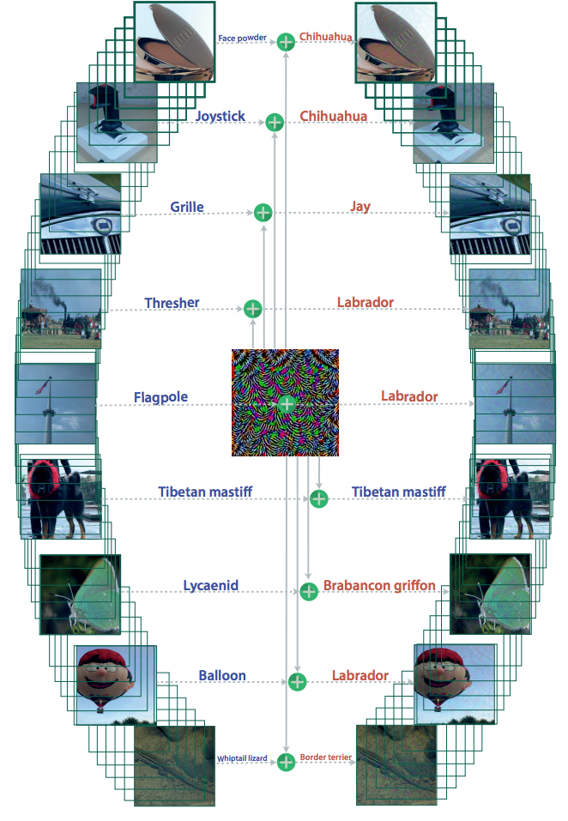
Universal Adversarial Examples
Even image agnostic noise
can break predictions
[Moosavi-Dezfooli, Fawzi,
Fawzi, Frossard, CVPR2017]

Slide 25
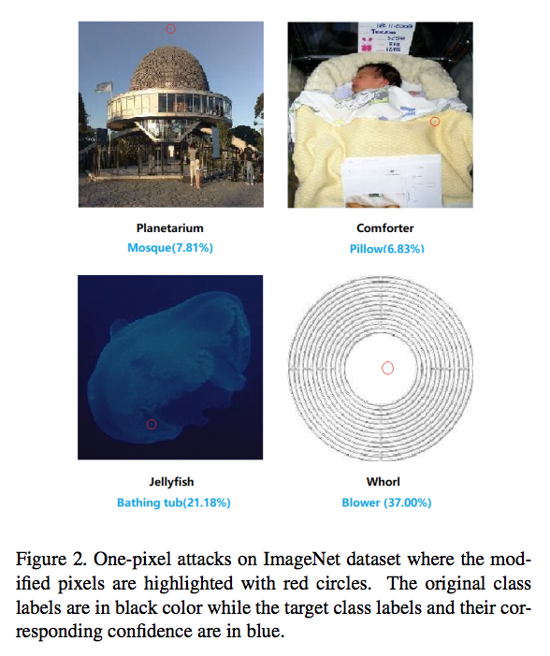
Single Pixel Attacks
[Su, Vargas, Kouichi 2017]

Slide 26
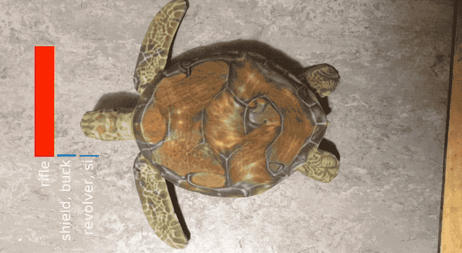
Adversarial Examples in Real Time

Slide 27
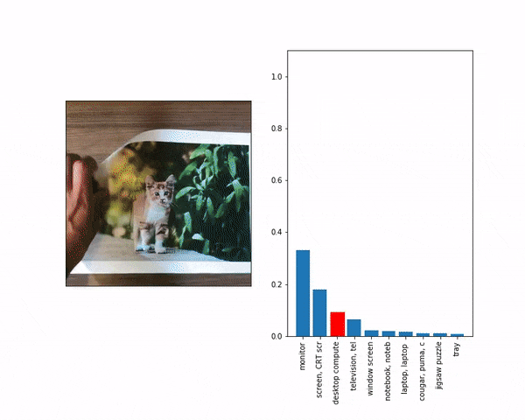
Adversarial Examples in Real Time

Slide 28
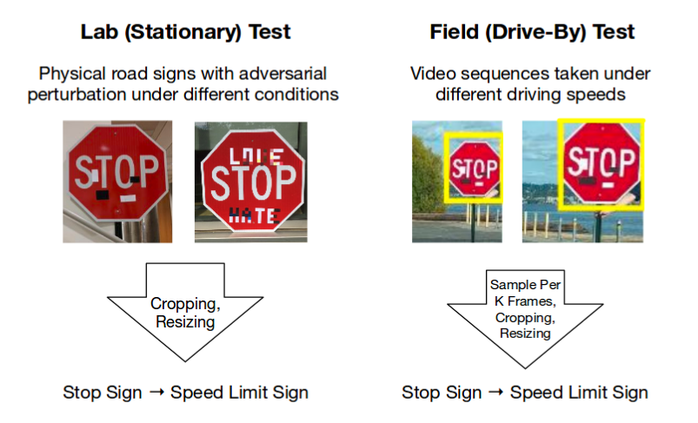
Adv. Example + ML in the wild
Eykholt, Evtimov, Fernandes, Bo Li, Rahmati,
Xiao, Prakash, Kohno, Song. CVPR2018]

Slide 29
Adversarial Examples: Why?
Classifiers are much less robust to adv. Noise
Let’s revisit the linear case

Slide 30
Worst-case Robustness
Let’s study the linear case:
Assume some margin:
Prediction
Class 1
Class 2

Slide 31
Worst-case Robustness
Assume additive perturbation
Unit norm
Q: What is the “worst” unit norm vector to add
Assume margin:
Goal
“γ-far” from boundary
How big is added term?

Slide 32
Worst-case Robustness
Worst case perturbation on linear models
Adversarial example
That is,
Worst-case noise
points towards boundary!

Slide 33
Worst-case Robustness
Worst case perturbation on linear models
Adversarial perturbation
Worst-case noise points
Towards boundary
How big is added term?

Slide 34
Worst-case Robustness
“Adversarial” Perturbation
Compare with Random Noise
Worst-case noise sqrt(d)
more effective!

Slide 35
Attacking Neural Networks

Slide 36
Robustness of Classification
Adversarial attack: Goal “maximize loss”!
max loss( predict( ); True Label )
st. norm( ) = small
goal
imperceptibility
How to formalize?

Slide 37
Threat Model

Slide 38
Threat Models
Simplest and still meaningful: “Black Box:”
just access to predictions
But, a powerful adversary can have access to:
predictions
gradients
model architecture
training data set
Training algorithm + defense mechanism
Compute power
Predict(x)
Input
Output

Slide 39
Types of Attack
Untargeted
Targeted
Different kinds of noise
can be l-0, l-infinity or l-2 bounded
Predict( ) = anything but cat
Predict( ) = Badger

Slide 40
General Attack Mechanism
Goal for a general learning problem
Taylor’s linear approximation
Linear approx problem
Goal: max this term

Slide 41
Fast Gradient Sign Method
Linear optimization
Usually p = ∞. Optimal perturbation:
FGSM:

Slide 42
Fast Gradient Sign Method
Linear optimization
Usually p = ∞
Iterative FGSM:

Slide 43
Fast Gradient Sign Method
Linear optimization
Usually p = ∞
Iterative targeted FGSM:
FGSM currently one of the fastest and effective attacks

Slide 44
Other Attack Frameworks

Slide 45
Szegedy et al. (2014)
Box constrained L-BFGS
Targeted attack

Slide 46
DeepFool (2016)
Un-targeted attack

Slide 47
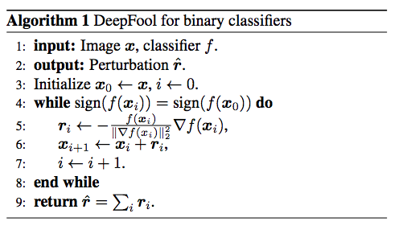
DeepFool (2016)
Un-targeted attack

Slide 48
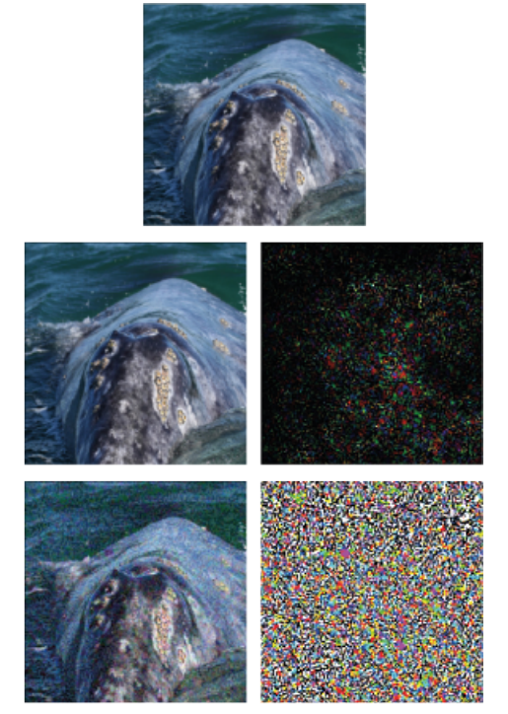
DeepFool
FGSM

Slide 49
C&W framework (2017)
Generalization of Szegedy et al

Slide 50
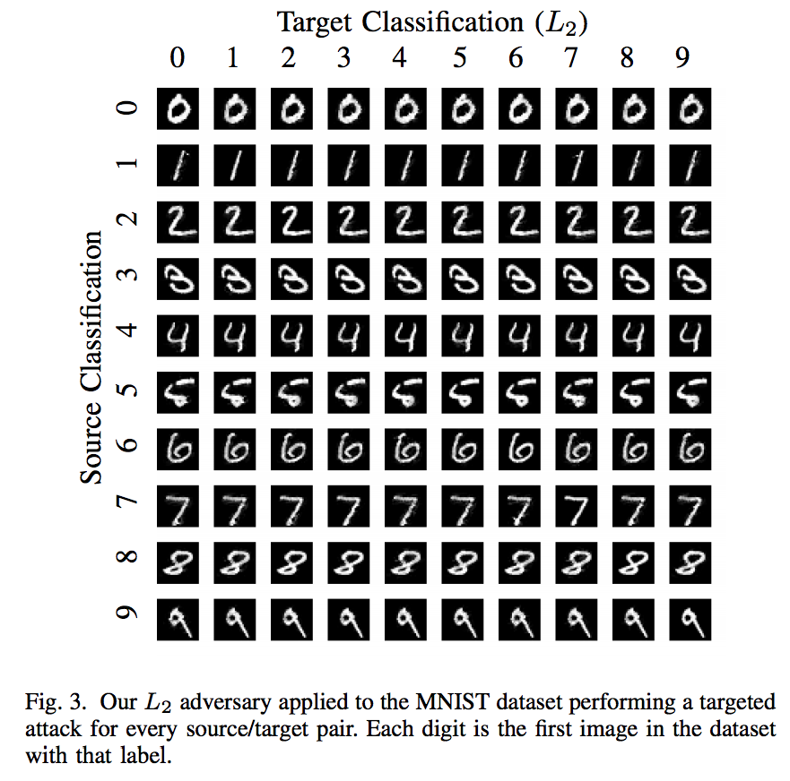
C&W framework (2017)

Slide 51
Defense??
Can we design defense mechanisms??
Defense
Predict(x)
Input
Output

Slide 52
Next time
Defense against Adv. Examples
Adversarial Attacks During Training
Robust Training

Slide 53
The end

